Slide 1
Intermediate Assignment Python
Margianto Ramadhani
Team 1 - Section Hamburg
Link Colab : https://colab.research.google.com/drive/1TFXamqizM9_IB4_7Hhkb_rU1zEf3euR0?usp=share_link

Slide 2
Table of contents
01
02
03
Business Overview
Dataset Information
Data Cleaning
04
05
06
Exploratory Data Analysis
Cluster Analysis
Recommendation
Business Background with Analytical Objective
Sources of Dataset with Data Dictionary
Cleaning process of all dataset
Descriptive statistics to get the insight of transaction trends
Clustering the data to get new insight
Summary of all insight from the dataset with recommendation

Slide 3
Business Overview

Slide 4
Business Background
01 Business Overview
You are a data analyst in an Indonesian investment startup which makes an application that can buy and sell mutual funds (Indonesian: reksadana). The mutual funds consist of: stocks mutual funds (saham), bond mutual funds (pendapatan tetap), money market mutual funds (pasar uang), and mixed-investment mutual funds (campuran). As the name suggests, the types reflect the underlying investment made by the Fund Manager for the mutual fund.
Mr Djoko as head of data, give you this problem to solve "What kinds of thematic campaigns that we can recommend to the marketing team for the next month?"
In the next month, the marketing team wants to create a thematic campaign based on user preference. You, as data analyst will be tasked to create a segmentation for this thematic campaign and give recommendations (as objective) on the themes on each campaign.

Slide 5
Analytical Objective
01 Business Overview
Create a segmentation for this thematic campaign and give recommendations on the themes on each campaign to the marketing team for the next month.

Slide 6
Dataset Information

Slide 7
Sources of Dataset
02 Dataset Information
users dataset (spreadsheet) https://docs.google.com/spreadsheets/d/1My4ZAqFkF2UDbegp5f5bmuoG0rN07P9agzbTNxB7XMU/edit?usp=share_link
daily_user_transaction dataset (spreadsheet) https://docs.google.com/spreadsheets/d/1EnPDMl2KZPpaSx898SWBRT1yHJfnR192jaSJNbKQ0Qs/edit?usp=share_link

Slide 8
Data Dictionary for users
02 Dataset Information
column | definition
user_id | Client ID on the platform
registration_import_datetime | Registration time and date at UTC+7 timezone (WIB)
user_gender | User self-identified gender
user_age | User self-identified age
user_occupation | User self-identified job
user_income_range | User self-identified income range
referral_code_used | If user enter referral code during registration, the value is "used referral"; else will be Null valued
user_income_source | User self-declared source of income
end_of_month_invested_amount | End of month total amount of mutual fund that are still invested in the platform
total_buy_amount | Total buying amount of mutual funds
total_sell_amount | Total selling amount of mutual funds

Slide 9
Data Dictionary for daily_user_transaction
02 Dataset Information
column | definition
user_id | Client ID on the platform
date | Date of the transaction
buy_saham_transaction_amount | Amount of Saham mutual fund that are bought by user at that date
sell_saham_transaction_amount | Amount of Saham mutual fund that are sell by user at that date
buy_pasar_uang_transaction_amount | Amount of Pasar Uang mutual fund that are bought by user at that date
sell_pasar_uang_transaction_amount | Amount of Pasar Uang mutual fund that are sell by user at that date
buy_pendapatan_tetap_transaction_amount | Amount of Pendapatan Tetap mutual fund that are bought by user at that date
sell_pendapatan_tetap_transaction_amount | Amount of Pendapatan Tetap mutual fund that are sell by user at that date

Slide 10
Data Dictionary for daily_user_transaction
02 Dataset Information
column | definition
buy_campuran_transaction_amount | Amount of Campuran mutual fund that are bought by user at that date
sell_campuran_transaction_amount | Amount of Campuran mutual fund that are sell by user at that date
total_buy_transaction_amount | Total mutual fund that are bought by user at that date
total_sell_transaction_amount | Total mutual fund that are sell by user at that date
saham_invested_amount | Amount of Saham mutual fund that are owned by user at that date (decrease from Day-1 if sell, increase if buy)
pasar_uang_invested_amount | Amount of Pasar Uang mutual fund that are owned by user at that date (decrease from Day-1 if sell, increase if buy)
pendapatan_tetap_invested_amount | Amount of Pendapatan Tetap mutual fund that are owned by user at that date (decrease from Day-1 if sell, increase if buy)
campuran_invested_amount | Amount of Campuran mutual fund that are owned by user at that date (decrease from Day-1 if sell, increase if buy)
total_invested_amount | Total amount of mutual fund that are owned by user at that date (decrease from Day-1 if sell, increase if buy)

Slide 11
Data Cleaning

Slide 12
Data Cleaning Preparation
03 Data Cleaning
Import the library that will be used on analysis
# import all libraries that will be used
import pandas as pd
import numpy as np
import matplotlib.pyplot as plt
import seaborn as sns
import plotly.express as px
from pandas import DataFrame

Slide 13
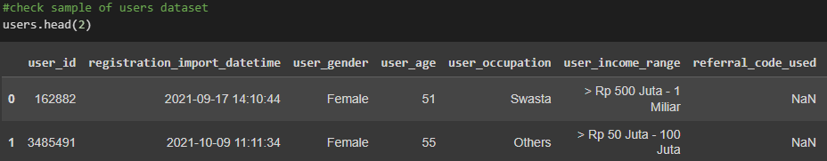
Read The Dataset Users
03 Data Cleaning
Import the dataset to colab for analysis
# Open Google Sheet file of users dataset
sheet_url = 'https://docs.google.com/spreadsheets/d/1My4ZAqFkF2UDbegp5f5bmuoG0rN07P9agzbTNxB7XMU/edit#gid=0'
sheet_url_trf = sheet_url.replace('/edit#gid=', '/export?format=csv&gid=')
print(sheet_url_trf)
users = pd.read_csv(sheet_url_trf)
Check the sample data of users dataset

Slide 14
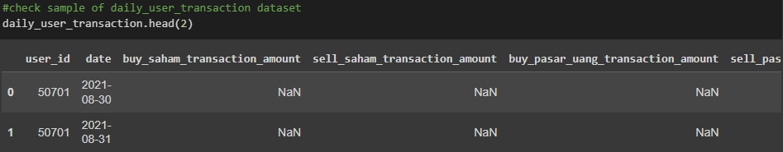
Read The Dataset daily_user_transaction
03 Data Cleaning
Import the dataset to colab for analysis
# Open Google Sheet file of daily_user_transaction
sheet_url = 'https://docs.google.com/spreadsheets/d/1EnPDMl2KZPpaSx898SWBRT1yHJfnR192jaSJNbKQ0Qs/edit#gid=0'
sheet_url_trf = sheet_url.replace('/edit#gid=', '/export?format=csv&gid=')
print(sheet_url_trf)
daily_user_transaction = pd.read_csv(sheet_url_trf)
Check the sample data of daily_user_transaction dataset

Slide 15
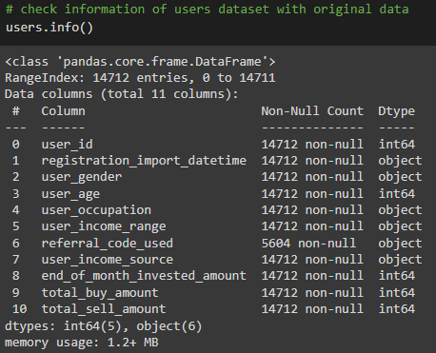
Check Information of users The Dataset
03 Data Cleaning
Insight
The dataset consist of 14712 rows and 11 columns
All columns name are known
The dataset consist data types int64(5) and object(6)
The referral_code_used field contains some null values

Slide 16
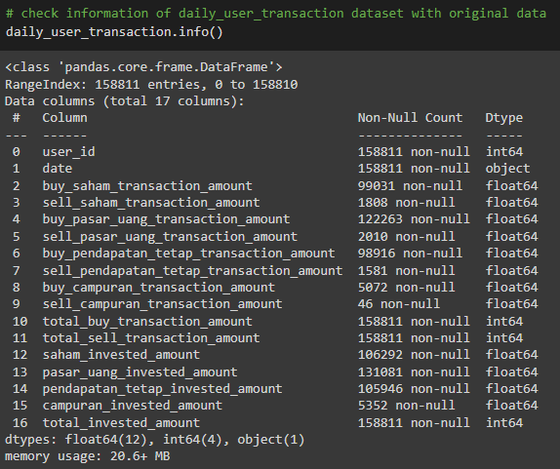
Check Information of daily_users_transaction
03 Data Cleaning
Insight
The dataset consist of 158811 rows and 17 columns
All columns name are known
The dataset consist data types float64(12), int64(4) and object(1)
The several columns contains some null values

Slide 17
Data Cleaning users
03 Data Cleaning
Data Cleaning Steps and Considerations (Elaborate The reason of Data Cleaning)
Removing Irrelevant values
Handling Missing Data
Removing Duplicates
String Manipulation
Time Series Manipulation

Slide 18
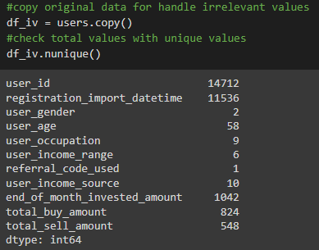
Removing Irrelevant Values
03 Data Cleaning
Insight
Columns user_id contains unique values 14712 from 14712 rows as primary key
The several columns have multiple defined options
Need to check on detailed values at several columns that may contains irrelevant values or typo

Slide 19
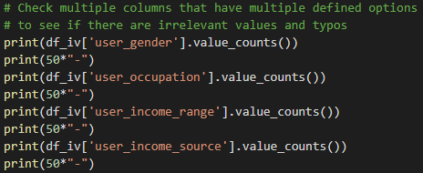
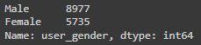
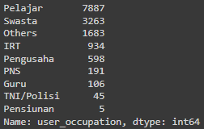
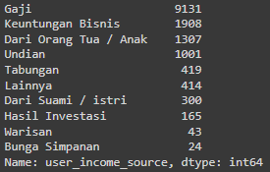
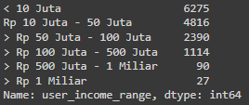
Removing Irrelevant Values
03 Data Cleaning
Insight
Based on unique values on several columns no irrelevant values and typos found

Slide 20
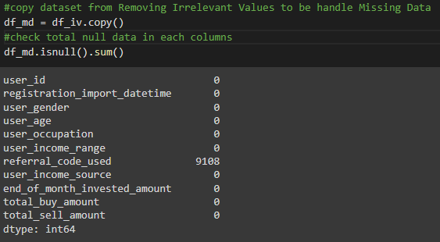
Handling Missing Data
03 Data Cleaning
Insight
From all columns, there is 1 column of referral_code_used has 9108 missing values from 14712 rows

Slide 21
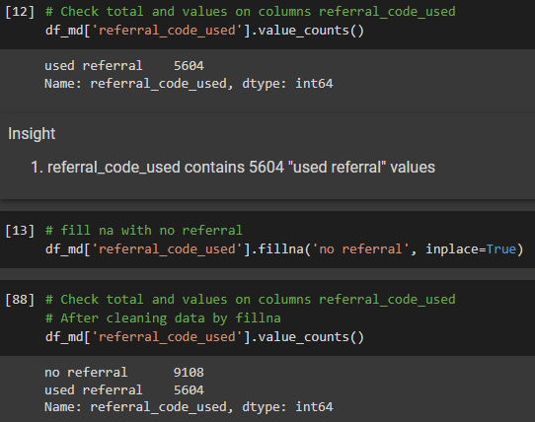
Handling Missing Data
03 Data Cleaning
Insight
1. referral_code_used contains 5604 "used referral" values
2. missing values has been filled by no referral that contains 9108 values

Slide 22
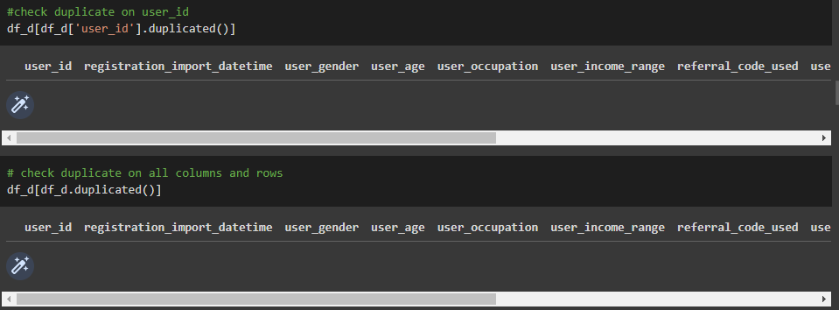
Removing Duplicates
03 Data Cleaning
Insight
No duplicate values at column user_id as a Primary Key
No duplicate values at all data

Slide 23
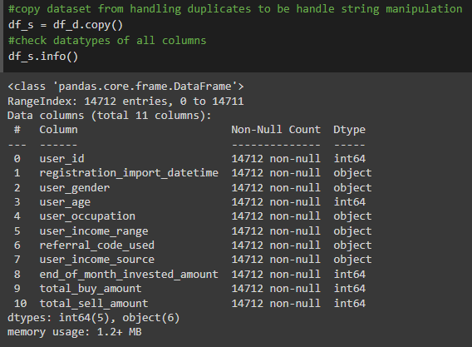
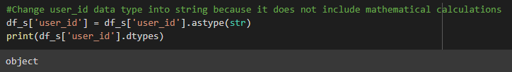
String Manipulation
03 Data Cleaning
Insight
1. Data type of user_id is int, but it cannot be included the mathematical calculation due to meaningless. So, better to convert the data type to be a string
2. user_id columns has been converted from integer to string due to it does not include mathematical calculations

Slide 24
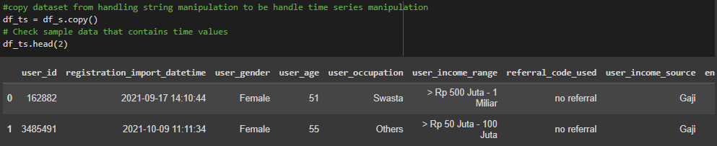
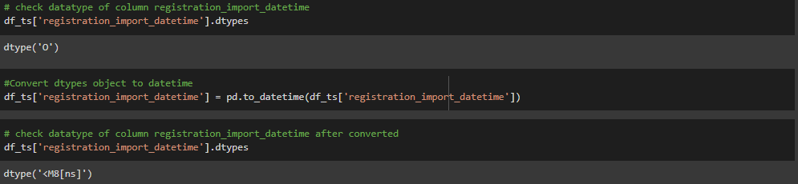
Time Series Manipulation
03 Data Cleaning
Insight
Only column registration_import_datetime that has data type date time
The column registration_import_datetime has been converted to datetime from string

Slide 25
Data Cleaning daily_users_transaction
03 Data Cleaning
Data Cleaning Steps and Considerations (Elaborate The reason of Data Cleaning)
Removing Irrelevant values
Handling Missing Data
Removing Duplicates
String Manipulation
Time Series Manipulation

Slide 26
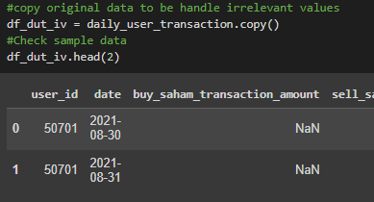
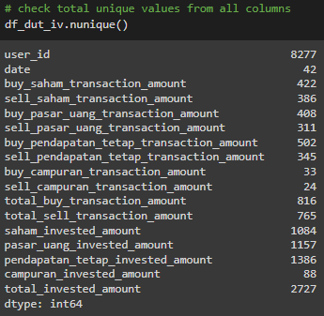
Removing Irrelevant Values
03 Data Cleaning
Insight
Columns user_id contains unique values 8277 from 158811 rows, so that there are several users making repeated transactions
all columns consist of unique values ​​according to different contents without any fixed options, so they do not contain irrelevant values

Slide 27
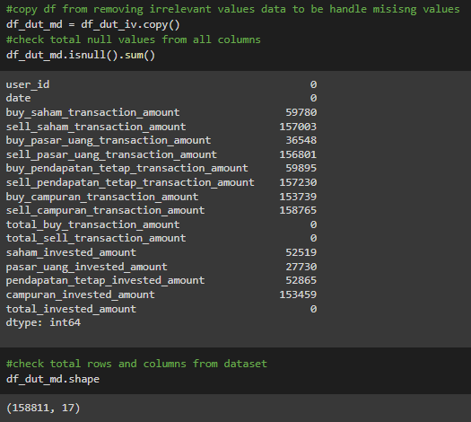
Handling Missing Data
03 Data Cleaning
Insight
Total rows of the dataset is 158811
There are many of columns have missing values, but it still make sense because there are many users that do not make the transaction

Slide 28
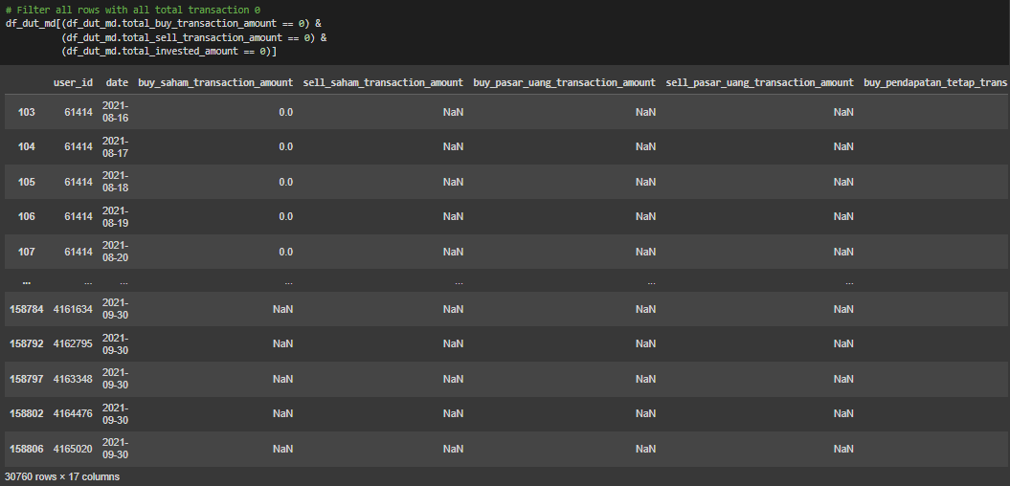
Handling Missing Data
03 Data Cleaning

Slide 29
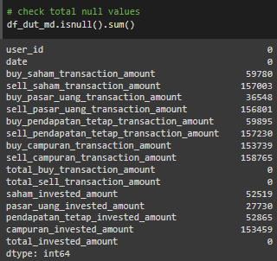
Handling Missing Data
03 Data Cleaning
Insight
The data with total transaction of buy, sell and invested equal to 0 is 30760 rows that shown there are no transaction made
Missing data only exist at transaction columns, it still make sense due to no transaction made
Leave the missing data as is condition for next deep analysis

Slide 30
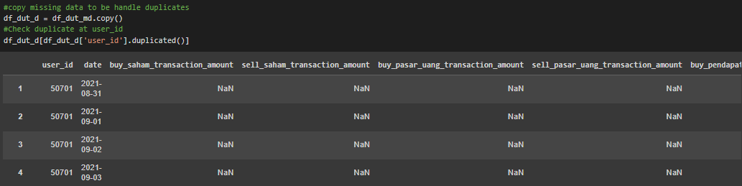
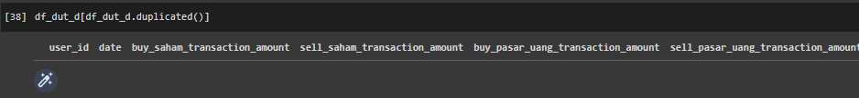
Removing Duplicates
03 Data Cleaning
Insight
All columns of user_id are normal to have duplicate data because they are daily transactions which are done by user id periodically
Overall data do not have duplicate data

Slide 31
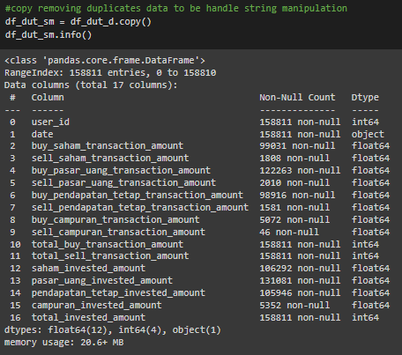
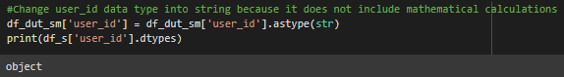
String Manipulation
03 Data Cleaning
Insight
From all columns only user_id that should be string data type based on its value that no need to do the mathematical analytics
user_id columns has been converted from integer to string due to it does not include mathematical calculations

Slide 32
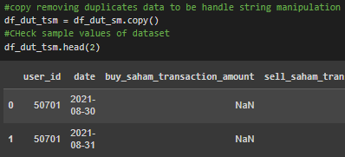
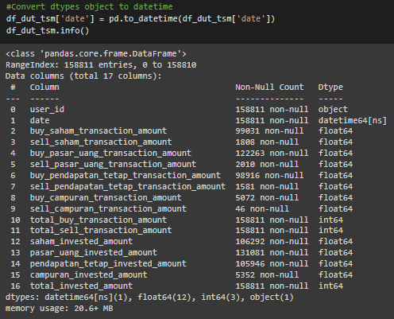
Time Series Manipulation
03 Data Cleaning
Insight
Only columns date that contains date values
date columns has been converted from string to date time due to this column contains times data

Slide 33
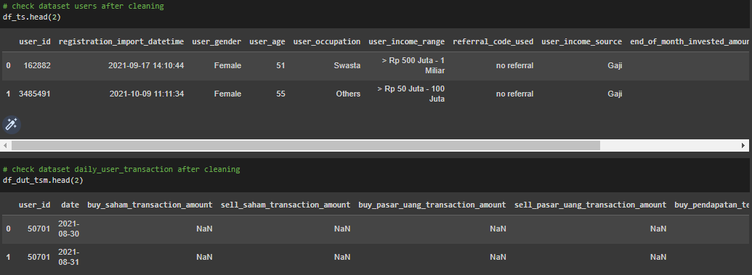
Join The Dataset
03 Data Cleaning
Check sample values of dataset

Slide 34
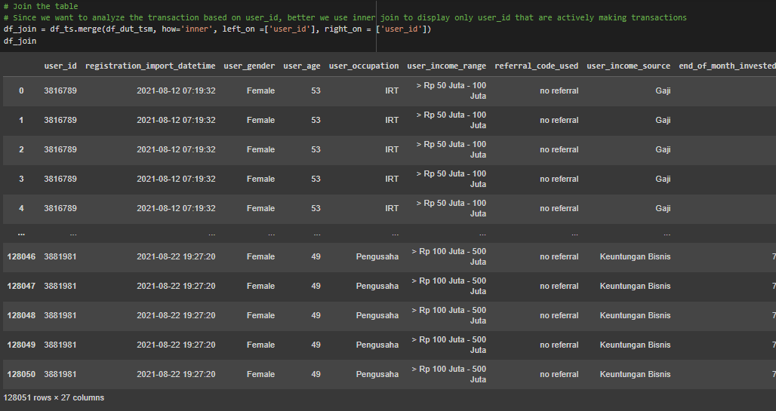
Join The Dataset
03 Data Cleaning
Do inner join of dataset

Slide 35
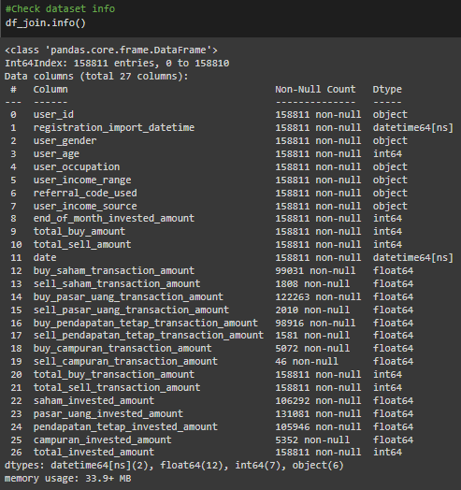
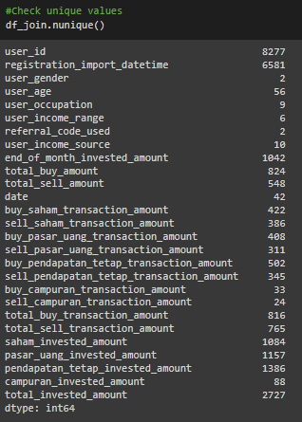
Join The Dataset
03 Data Cleaning
Check the dataset info and unique values after joining the table

Slide 36
Join The Dataset
03 Data Cleaning
Check the overall duplicate values
Insight
1. There is same column on table user and daily_user_transaction as PK that can be used for join the table
2. Inner join is selected for this case so that the results obtained are intersecting data in accordance with the required analysis
3. Total rows after join is 158811, that show the total of transaction
4. There are many missing values on column transaction that still make sense due to there is no transaction in one of transaction type
5. Total unique values from user_id is 8277 which means only 8277 active users make transactions from 14712 registered users
6. After cross check of duplicates value, there is no duplicates on all rows and columns

Slide 37
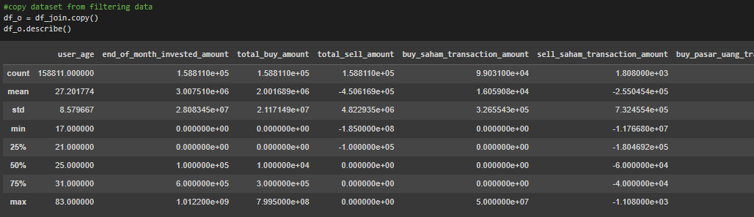
Handling Outliers
03 Data Cleaning
Check the describe of dataset

Slide 38
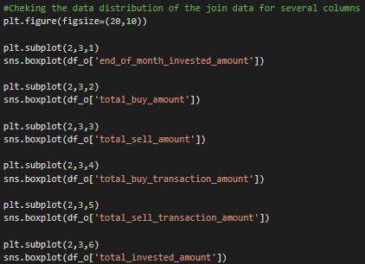
Handling Outliers
03 Data Cleaning
Check distribution of data

Slide 39
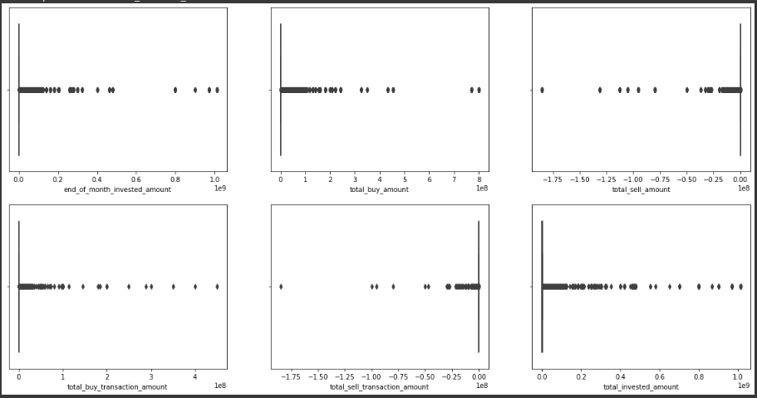
Handling Outliers
03 Data Cleaning
The result of distributed data use boxplot

Slide 40
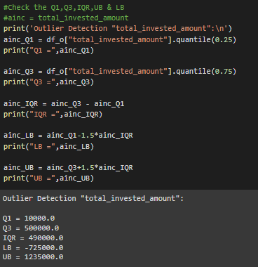
Handling Outliers
03 Data Cleaning
Check outliers of sample columns

Slide 41
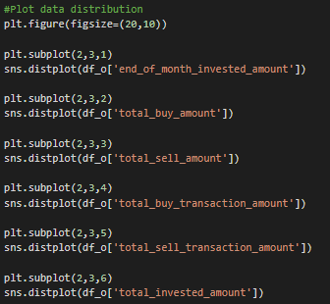
Handling Outliers
03 Data Cleaning
Check data distribution of sample columns for skewness

Slide 42
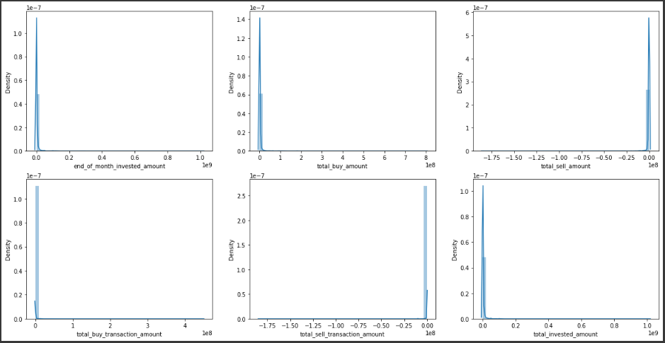
Handling Outliers
03 Data Cleaning
The result of distributed data to check skewness

Slide 43
Handling Outliers
03 Data Cleaning
Insight
1. From several of the analytics above regarding of outliers and distribution data, it was found that the results were distorted due to the large number of range values and empty data
2. In this case all data is left in its original condition, because all data is important and still makes sense in this condition

Slide 44
Exploratory Data Analysis

Slide 45
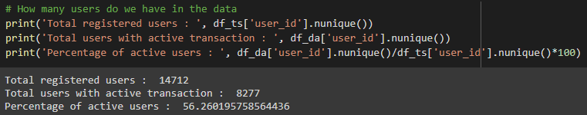
EDA - Descriptive Statistic
04 Exploratory Data Analysis
a. How many users do we have in the data?
Insight
Total registered users are 14712
Total users with active transaction are 8277
Total active users only 56.26%

Slide 46
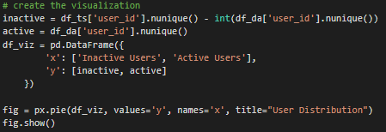
EDA - Descriptive Statistic
04 Exploratory Data Analysis
Create the visualization by pie chart

Slide 47
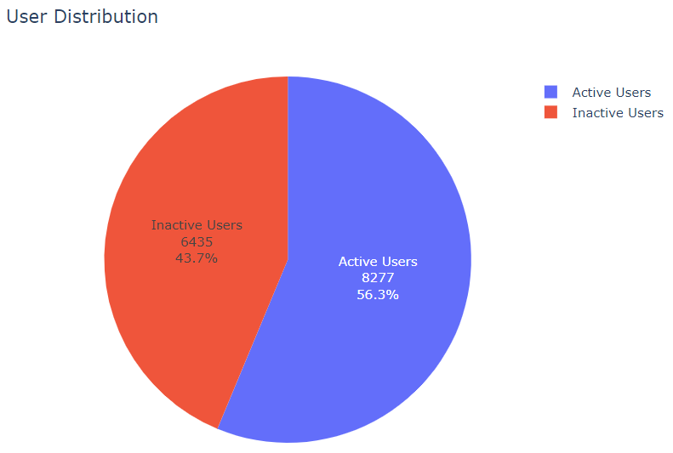
EDA - Descriptive Statistic
04 Exploratory Data Analysis
a. How many users do we have in the data?
Insight
Total registered users are 14712
Total users with active transaction are 8277 or 56.3%
Total inactive users are 6435 or 43.7%

Slide 48
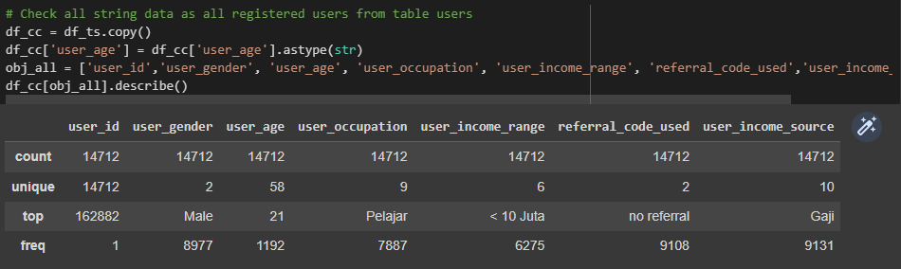
EDA - Descriptive Statistic
04 Exploratory Data Analysis
b. How is the demographic in the data?

Slide 49
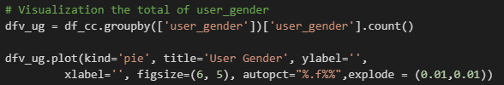
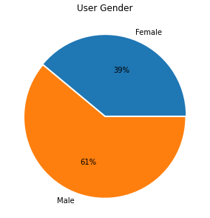
EDA - Descriptive Statistic
04 Exploratory Data Analysis
The demographic data of user_gender
Insight
Total registered users are 14712
Total male users are 8977 or 61%
Total female users are 5735 or 39%

Slide 50
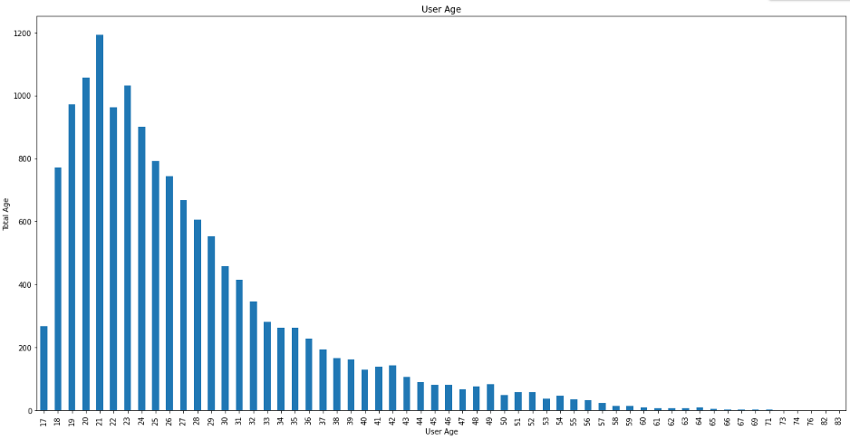
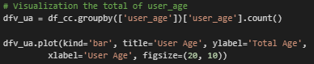
EDA - Descriptive Statistic
04 Exploratory Data Analysis
The demographic data of user_age
Insight
The range of user age is 17 – 83 years old
The most user age of the user is 21 with frequency 1192

Slide 51
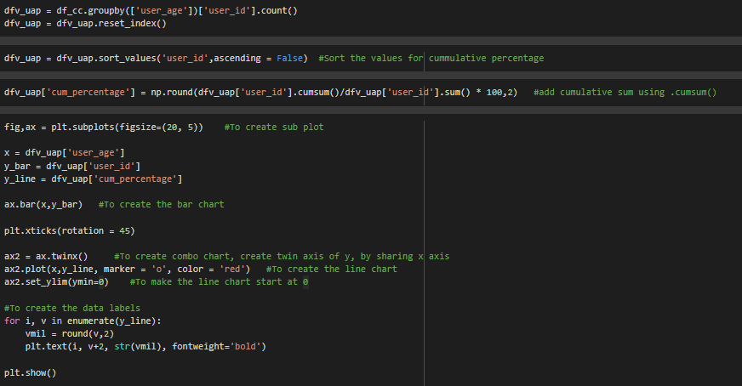
EDA - Descriptive Statistic
04 Exploratory Data Analysis
The demographic data of user_age by pareto

Slide 52
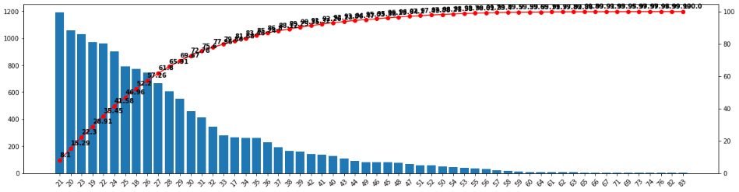
EDA - Descriptive Statistic
04 Exploratory Data Analysis
The demographic data of user_age by pareto
Insight
Based on pareto method, It is known that 80% of the age range which is the majority of 20% of total users has a range of 17-33

Slide 53
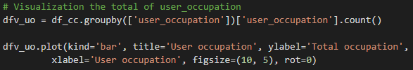
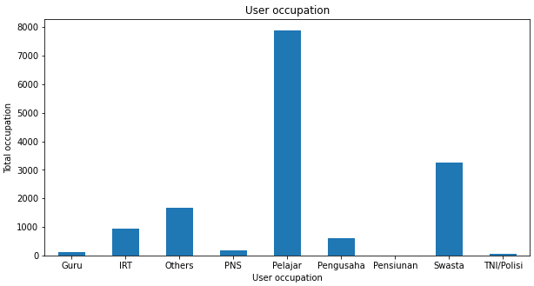
EDA - Descriptive Statistic
04 Exploratory Data Analysis
The demographic data of user_occupation
Insight
The most user occupation is pelajar with frequency 7887 from 8 the other occupations

Slide 54


EDA - Descriptive Statistic
04 Exploratory Data Analysis
The demographic data of user_income_range
Insight
The range of user income is from <10jt until > 1M
The most user income is <10 Juta with frequency 6275

Slide 55


EDA - Descriptive Statistic
04 Exploratory Data Analysis
The demographic data of user_income_source
Insight
The most user income source is from gaji with frequency 9131 far above the other 9 sources

Slide 56


EDA - Descriptive Statistic
04 Exploratory Data Analysis
b. How is the demographic in the data?

Slide 57
EDA - Descriptive Statistic
04 Exploratory Data Analysis
b. How is the demographic in the data?
1. The demographic data user get from users table as the registered users
2. The most user gender that use application to buy and sell mutual funds is Male with frequency 8977 from total user 14712
3. The most user age that use application to buy and sell mutual funds is 21 with frequency 1192 from total user 14712 with a majority age from 17-33
4. The most user occupation that use application to buy and sell mutual funds is Pelajar with frequency 7887 from total user 14712
5. The most user income that use application to buy and sell mutual funds is <10 Juta with frequency 6275 from total user 14712
6. The most user income user that use application to buy and sell mutual funds is from Gaji with frequency 9131 from total user 14712

Slide 58

EDA - Descriptive Statistic
04 Exploratory Data Analysis
c. How many users buy products in each mutual fund?

Slide 59


EDA - Descriptive Statistic
04 Exploratory Data Analysis
c. How many users buy products in each mutual fund?

Slide 60


EDA - Descriptive Statistic
04 Exploratory Data Analysis
c. How many users buy products in each mutual fund?
Insight
Total transaction of buy_saham_transaction_amount is 3471 from 1938 user_id
Total transaction of buy_pasar_uang_transaction_amount is 4426 from 2359 user_id
Total transaction of buy_pendapatan_tetap_transaction_amount is 4086 from 2240 user_id
Total transaction of buy_campuran_transaction_amount is 131 from 78 user_id

Slide 61

EDA - Identify Key Trends in The Dataset
04 Exploratory Data Analysis
a. Is there any trend on the transaction?

Slide 62


EDA - Identify Key Trends in The Dataset
04 Exploratory Data Analysis
a. Is there any trend on the transaction?

Slide 63

EDA - Identify Key Trends in The Dataset
04 Exploratory Data Analysis
a. Is there any trend on the transaction?

Slide 64


EDA - Identify Key Trends in The Dataset
04 Exploratory Data Analysis
a. Is there any trend on the transaction?

Slide 65
EDA - Identify Key Trends in The Dataset
04 Exploratory Data Analysis
a. Is there any trend on the transaction?
The total trend of buying mutual funds from the period August 04, 2021 to September 30, 2021 experienced ups and downs with the final total transactions increasing rapidly
The maximum total buy transaction is 827.5414M
The mean of total buy transaction is 295.2040M
Total users who make transactions continue to increase during the existing period
Even though there has been an increase and decrease in total purchase transactions, the number of users making transactions continues to increase

Slide 66

EDA - Identify Key Trends in The Dataset
04 Exploratory Data Analysis
b. How about transaction trends for each product?

Slide 67

EDA - Identify Key Trends in The Dataset
04 Exploratory Data Analysis
b. How about transaction trends for each product?

Slide 68

EDA - Identify Key Trends in The Dataset
04 Exploratory Data Analysis
b. How about transaction trends for each product?

Slide 69


EDA - Identify Key Trends in The Dataset
04 Exploratory Data Analysis
b. How about transaction trends for each product?

Slide 70
EDA - Identify Key Trends in The Dataset
04 Exploratory Data Analysis
b. How about transaction trends for each product?
The highest total transactions were on Pendapatan Tetap followed by Pasar Uang, Saham and campuran
The highest transaction on pendapatan tetap is 576.4888M with mean values is 155.9799M
The highest transaction on pasar uang is 447.9010M with mean values is 88.70569M
The highest transaction on saham is 135.5793M with mean values is 37.86540M
The highest transaction on campuran is 58.000M with mean values is 12.65302M
All buy transactions for each product experienced increases and decreases, but relatively increased at the end of the period except mixed transactions
The increase and decrease in the number of transactions is very high in pendapatan tetap products

Slide 71
Cluster Analysis

Slide 72

Clustering Analysis
05 Cluster Analysis
Copy the dataset from table join for clustering analysis and check the information to get insight for clustering

Slide 73

Clustering Analysis
05 Cluster Analysis
Based on the relationship of each column and the completeness of the values ​​of each column, clustering can be made between the user_id and date columns to get the frequency of active users in the last 2 months according to the dataset. This grouping of active users is based on the date of transaction so that it can be concluded that all users in the daily user table are active even though they do not make transactions or transactions value are 0

Slide 74

Clustering Analysis
05 Cluster Analysis
Merge the table frequency with user to next analysis and do reset index as a dummy column user_id for clustering
Insight
Total rows of dataset decrease from 14712 to 8277 after merge due to only active users from period 2 month from table daily that merge

Slide 75


Clustering Analysis
05 Cluster Analysis
Check distribution data with boxplot
Insight
Based on boxplot result, both of column have a good data with normal distribution and no outliers

Slide 76

Clustering Analysis
05 Cluster Analysis
Create new variable of dataset for clustering between index as a dummy user_id and frequency

Slide 77


Clustering Analysis
05 Cluster Analysis
Check distribution of data by scatter plot with standard scale due to the difference in x and y data which is far enough so that the analysis results are more accurate
Insight
The results of the scatter plot show that the distribution of data is neat and even so that the clustering process can be continued

Slide 78

Clustering Analysis
05 Cluster Analysis
Do K-Means clustering by elbow method

Slide 79

Clustering Analysis
05 Cluster Analysis
The result of elbow method
Insight
Based on elbow method, the optimal k values is between 2 until 4, so we can create the clustering between 2, 3 or 4 cluster.
to confirm the best number of k values ​​that we can use, we can check further using silhouette method

Slide 80



Clustering Analysis
05 Cluster Analysis
Do K-Means clustering by silhouette method

Slide 81

Clustering Analysis
05 Cluster Analysis
The result of silhouette method with n_cluster = 2 with The average silhouette_score is : 0.5344165733550114

Slide 82

Clustering Analysis
05 Cluster Analysis
The result of silhouette method with n_cluster = 3 with The average silhouette_score is : 0.46421510976916225

Slide 83

Clustering Analysis
05 Cluster Analysis
The result of silhouette method with n_cluster = 4 with The average silhouette_score is : 0.5210779680425659

Slide 84

Clustering Analysis
05 Cluster Analysis
Based on silhouette score and the chart, the best n_cluster is 2, but for this case we need clustering the data more than 2, so we can use n_cluster 3. But it is necessary to check the distribution of the data using a boxplot to ensure that the data distribution does not overlap so that the clustering results are still valid and can be used .

Slide 85



Clustering Analysis
05 Cluster Analysis
The boxplot result of clustering data
Insight
Based on boxplot result of data, the distribution data still good with no extreme overlap between cluster

Slide 86
Clustering Analysis
05 Cluster Analysis
5A. Method and variable used for clustering, metrics used to justify the cluster (elbow, silhouette)
Insight
Based on the analysis clustering to get optimum k-means with elbow and silhouette method and confirm the data by boxplot, we get n cluster is 3 and we can clustering the data by 3 segments

Slide 87


Interpreting Cluster Result and Recommendations
05 Cluster Analysis
Clustering segmentation
Insight
Cluster 0 consist of 2396 user, cluster 1 consist of 3001 users and cluster 2 consist of 2880 users

Slide 88
Interpreting Cluster Result and Recommendations
05 Cluster Analysis
The descriptive statistic of clustering dataset
 | cluster | 0 | 1 | 2
user_id | count | 2396 | 3001 | 2880
 | mean | 1825.52462 | 6747.8 | 3342.40278
 | min | 0 | 3843 | 1
 | max | 8266 | 8276 | 8176
 | median | 1846.5 | 6768 | 3829.5
frequency | count | 2396 | 3001 | 2880
 | mean | 33.809683 | 8.371543 | 18.291667
 | min | 21 | 1 | 1
 | max | 42 | 39 | 39
 | median | 34 | 7 | 19
Insight
The mean and median data from the show a significant difference so that the clustering process is correct, and insights can be sought in the next analysis

Slide 89


Interpreting Cluster Result and Recommendations
05 Cluster Analysis
Clustering of Frequency
Insight
1. The cluster 0 have average of active user 8 as the lowest frequency
2. The cluster 1 have average of active user 34 as the highest frequency
3. The cluster 2 have average of active user 18 as the medium frequency

Slide 90




Interpreting Cluster Result and Recommendations
05 Cluster Analysis
The Average of Total transaction by cluster

Slide 91
Interpreting Cluster Result and Recommendations
05 Cluster Analysis
The Average of Total transaction by cluster insight
Cluster 0 as lowest active user. Based on the chart and data shows that users are long-terms trades or investors who are rarely active for transactions, but when making transactions, they issue large amounts of money for investments or sell large amounts of assets because profits are already high.
Cluster 1 as highest active user. Based on the chart and data shows that user is a very active trader, where they are very active in making transactions. the total amount issued is not too large, but due to the very high transaction frequency so that it accumulates in a high total transaction.
Cluster 3 as medium active user. Based on the chart and data shows that user is a between trader and investor. They invest carefully and considerately, so that not many transactions are carried out and only carry out periodic checks to make sure their assets are profitable or losing
From the distribution of data between buy, sell and invest the three clusters look similar, it's just that the number of transactions that exist are very different.

Slide 92



Interpreting Cluster Result and Recommendations
05 Cluster Analysis
User occupation distribution
Insight
based on their occupation, the distribution of data is quite even in the three clusters with students dominating the users

Slide 93



Interpreting Cluster Result and Recommendations
05 Cluster Analysis
User gender distribution and user age
Insight
From the existing gender data, the highest number of men are in cluster 1. So, it can be concluded that most men prefer long-term investments while women are in cluster 2 so they are still quite careful in making investments.
The highest age in each cluster is same, namely age 21 with an average of 27

Slide 94



Interpreting Cluster Result and Recommendations
05 Cluster Analysis
User income range distribution
Insight
The distribution of user income in each cluster is quite even, this is also influenced by user occupation and the needs of each person in making investments

Slide 95



Interpreting Cluster Result and Recommendations
05 Cluster Analysis
User income source
Insight
Most of the salary and keuntungan bisnis are used for mid and long-term investments on cluster 0 and 2
Undian is mostly used for trading in cluster 1.

Slide 96





Interpreting Cluster Result and Recommendations
05 Cluster Analysis
Total buy by daily transaction

Slide 97
Interpreting Cluster Result and Recommendations
05 Cluster Analysis
Total buy by daily transaction insight
The distribution of investment types in each cluster is almost the same, only differing in the total amount
Transaction mix has the highest number of transactions followed by pendapatan tetap, pasar uang dan saham
Based on the number of daily purchase transactions, cluster 0 has the highest total transactions followed by clusters 1 and 2
Cluster 0 shows the high purchase transactions made by users who are less active. this can happen because they only make occasional buy transactions for investments with larger amounts of money as a long terms trader or investor

Slide 98





Interpreting Cluster Result and Recommendations
05 Cluster Analysis
Total Sell by daily transaction

Slide 99
Interpreting Cluster Result and Recommendations
05 Cluster Analysis
Cluster interpretation
CLuster |  | 0 | 1 | 2
Frequency |  | 8 | 34 | 18
User Age (mean) |  | 27 | 27 | 27
Gender | Male | 2004 | 1433 | 1739
 | Female | 997 | 967 | 1137
Income Range (most) |  | < 10 Juta | < 10 Juta | < 10 Juta
User Occupation (most) |  | Pelajar | Pelajar | Pelajar
User Income Source (most) |  | Gaji | Gaji | Gaji
End of Month Invested Amount (mean) |  | 1750478 | 3421350 | 2715255
Total Sell Amount (mean) |  | -71406 | -676364 | -204416
Total Buy Amount (Mean) |  | 770909 | 2471522 | 1444165
Segmentation Name |  | The Confident traders | The Conservative long-term traders | The Risk intolerant

Slide 100
Interpreting Cluster Result and Recommendations
05 Cluster Analysis
Total Sell by daily transaction insight
The largest total sales transactions occurred in cluster 1. This shows that the number of active users makes buying and selling transactions faster, thus increasing the total sales transactions. With campuran transactions being the highest point of sales in all clusters.
Cluster 0 with very few active user frequencies shows the least total sales. When compared with the total daily purchases which are very large and with the daily sales which are few, it shows that cluster 0 is focused on long-term investment as an investor

Slide 101
Interpreting Cluster Result and Recommendations
05 Cluster Analysis
5B. Cluster Characteristics
1. Cluster 0 with the high frequency as “The Confident traders”
The Confident traders have the highest levels of confidence and control and are the most active traders. These experienced investors are older and have the largest portfolios.
2. Cluster 1 with low frequency as “The Conservative long-term traders”
The Conservative long-term traders have low ratings for control and confidence and, therefore, invest primarily in mutual funds and This groups trades less actively and checks their investments infrequently.
3. Cluster 2 with the medium frequency as “The Risk intolerant”
The Risk intolerant group have medium levels of confidence and control. They are not active traders but do check their investments frequently.

Slide 102
Recommendation

Slide 103
Recommendation
06 Recommendation
5.B Business Recommendations based on character
1. Cluster 0 with low frequency as “The Conservative long-term traders”
- Cluster 0 consists of users who are less active but are very focused on investment. We can do campaigns by sending emails or notifications as a reminder for them to make transactions. We also may make additional features to make it easier for users to invest automatically based on certain dates and conditions to make it easier for them to keep investing if they forget.
2. Cluster 1 with the high frequency as “The Confident traders”
- Cluster 1 consists very active users, we can provide administrative fee discounts when making transactions so they can transact more often
3. Cluster 2 with the medium frequency as “The Risk intolerant”
- Cluster 3 is a user who is very careful in investing and aims at profits with little risk, so we can provide promos in the form of referral codes to get additional benefits so that they are more enthusiastic about investing and looking for new users

